Slide 1
Exegetical Outlining
31
Part 1:
How to outline based on the text
Dr. Rick Griffith • Jordan Evangelical Theological Seminary • BibleStudyDownloads.org

Slide 2
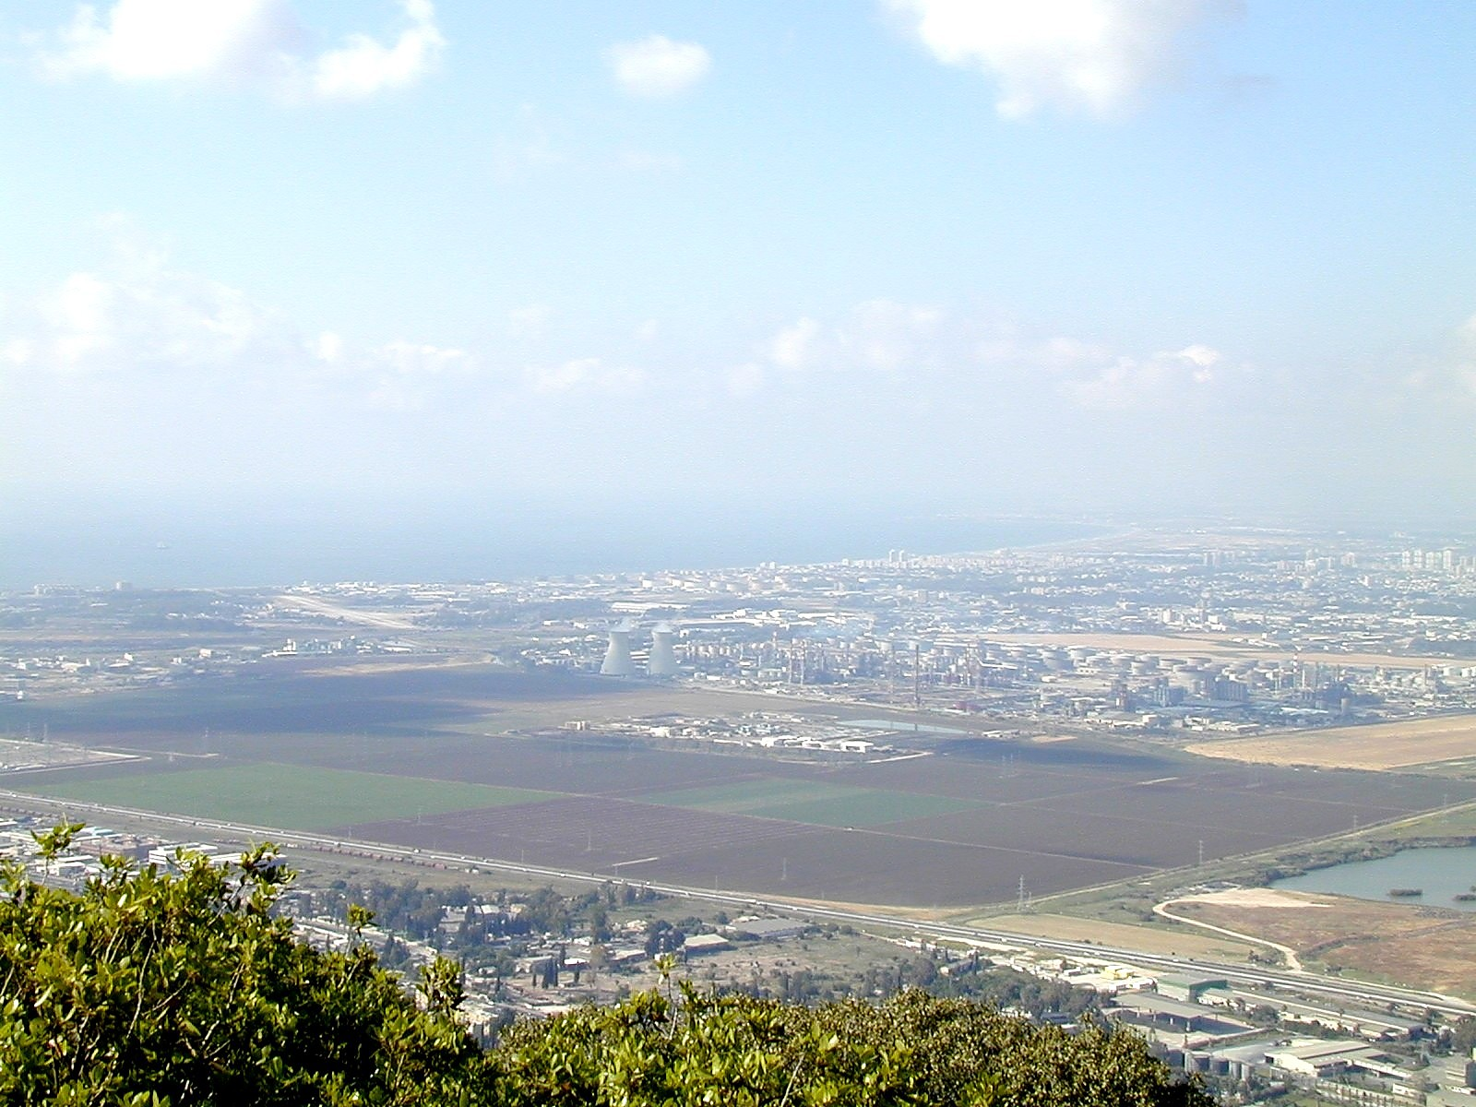
Let's first get an overview of the entire expository sermon preparation process...
This appears in chart form on page 251
Then the same process is in outline form on pages 27-28

Slide 3
The Preparing Expository Sermons Process
27-28, 251
Based on Ramesh Richard's text, Preparing Expository Sermons
TEXT
SERMON
5 Desired Listener Response
Brain
4 The Three
Developmental
Questions
Purpose Bridge
3.2 Exegetical Idea
CPT
Heart
CPS
6 Homiletical Idea
7 Homiletical
Outline
8 Clarity
9 Intro/Concl
3.1 Exegetical
Outline
Structure
Skeleton
Structure
2 Analyze Text
Study
Flesh
Preach
10 MSS &
Preach
1 Choose Text
White text shows 10 steps adapted from Haddon Robinson, Biblical Preaching (notes, 105)
Notes:
Cover steps 1-3 on page 27

Slide 4
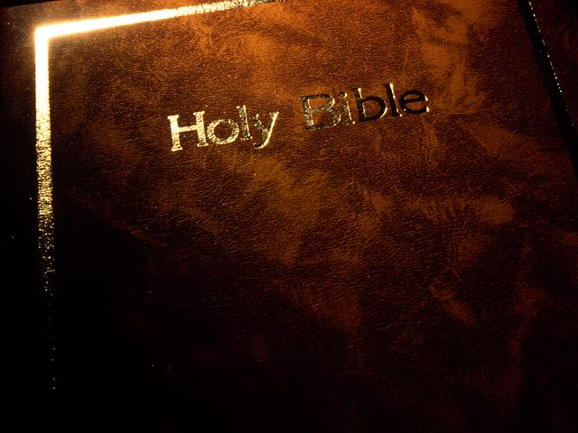
1. Study the Text
27
a. Choose the Text before Tuesday; make sure it is not too long for a single message.
b. Exegete the Passage (Analyze the Parts) and Gather Your Notes.

Slide 5
1. Study the Text
27
b. How to Exegete the Passage...
1) Pray for wisdom, read the translation most of your church members use, and list every question your members would ask (or 15 study hours later you'll have all the answers but will have forgotten the questions). Answer these questions.
2) Read a few other translations and note the differences and additional questions.
3) Read the original text if you can; use tools and do brief word studies on important words.

Slide 6
1. Study the Text
27
4) Consult commentaries if you are stuck (most of the time I do this after step 5).
a) Look up difficulties in Greek or Hebrew commentaries (if you can read them!).
b) See the Expositor's Bible Commentary for both the big picture and problem areas.
c) Read a sermonic commentary (by Stott, Wiersbe, Boice, Criswell, Swindoll, etc.).

Slide 7
Let's try it on Matthew 18:15-20
27
b. How to Exegete the Passage...
1) Pray for wisdom, read the translation most of your church members use, and list every question your members would ask (or 15 study hours later you'll have all the answers but will have forgotten the questions). Answer these questions.
2) Read a few other translations and note the differences and additional questions.
3) Read the original text if you can; use tools and do brief word studies on important words.

Slide 8
Matthew 18:15-20 (NIV 1984 ed.)
34a-b
What questions do you have about this text?
If your brother sins against you, go and show him his fault, just between the two of you. If he listens to you, you have won your brother over. ¹⁶But if he will not listen, take one or two others along, so that 'every matter may be established by the testimony of two or three witnesses.' ¹⁷If he refuses to listen to them, tell it to the church; and if he refuses to listen even to the church, treat him as you would a pagan or a tax collector.
¹⁸I tell you the truth, whatever you bind on earth will be bound in heaven, and whatever you loose on earth will be loosed in heaven. ¹⁹Again, I tell you that if two of you on earth agree about anything you ask for, it will be done for you by my Father in heaven. ²⁰For where two or three come together in my name, there am I with them.
Notes:
two main teachings on restoring Christians in sin

Slide 9
Matthew 5:23-24
?
"Therefore if you are presenting your offering at the altar, and there remember that your brother has something against you, leave your offering there before the altar and go; first be reconciled to your brother, and then come and present your offering."

Slide 10


Matthew's Relational Pillars
Matthew's Relational Pillars
5:23-24
You are:
Offender
Issue:
General
Notes:
Have you ever had a problem with another believer? (If you say "no," then I wonder which planet you have been living on!) Are you in fellowship with every Christian that you know now—your family members, your work colleagues, your neighbors and friends? If you're not in harmony, what should you do?

Slide 11


Matthew 5:23-24

Slide 12
Matthew's Relational Pillars
Matthew's Relational Pillars
5:23-24
18:15-17
You are:
Offender
Offended
Issue:
General
Sin

Slide 13



How do we restore sinning Christians properly?
Our First Question Today (for vv. 15-17)
34d
Notes:
HOM 08.13
HOM 11.25
HOM 12.18
HSB

Slide 14
Matthew 18
34a
Purpose
The Value of
One
1
1
Child (1-9)
1
Sheep
(10-14)
1
Sinner
(15-20)
1
Debtor
(21-35)
Notes:
Context: The value of one child (1-9), one sheep (10-14), one sinner (15-20), one debtor (21-35).
15-20 at the heart (advance slide to read)

Slide 15
Matthew 18:15-20 (NIV 1984 ed.)
If your brother sins against you, go and show him his fault, just between the two of you. If he listens to you, you have won your brother over. ¹⁶But if he will not listen, take one or two others along, so that 'every matter may be established by the testimony of two or three witnesses.' ¹⁷If he refuses to listen to them, tell it to the church; and if he refuses to listen even to the church, treat him as you would a pagan or a tax collector.
¹⁸I tell you the truth, whatever you bind on earth will be bound in heaven, and whatever you loose on earth will be loosed in heaven. ¹⁹Again, I tell you that if two of you on earth agree about anything you ask for, it will be done for you by my Father in heaven. ²⁰For where two or three come together in my name, there am I with them.
How to Restore
15-17
Why to Restore
18-20
Notes:
HOM 08.15; 09.32
HOM 16.12 focuses only on verses 15-17
HSB 20.32
HSB 25.08

Slide 16

The Point of Verses 15-17
34c
I. The way the church should correctly restore a sinning Christian is by keeping the matter as private as possible (15-17).
Notes:
08.16
11.26

Slide 17
Our Goal:
Restoration!
Notes:
08.17
11.27

Slide 18

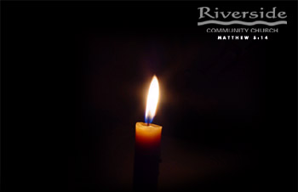
Restore People in Sin
Restore People in Sin
"Brothers, if someone is caught in a sin, you who are spiritual should restore him gently."
Galatians 6:1

Slide 19
God's 4-step restoring process…
34d
4
3
2
1
…reveals the issue to more people each step

Slide 20

Step 1 to Restoration
Talk to the person by yourself
34d
M
M
M
M
M
M
M
M
M
M
M
M
M
M
M
M
S
M
M
M
M
M
M
M
M
M
M
M
S = Sinner
M = Member

Slide 21
Matthew's Relational Pillars
Matthew's Relational Pillars
5:23-24
18:15-17
You are:
Offender
Offended
Issue:
General
Sin

Slide 22
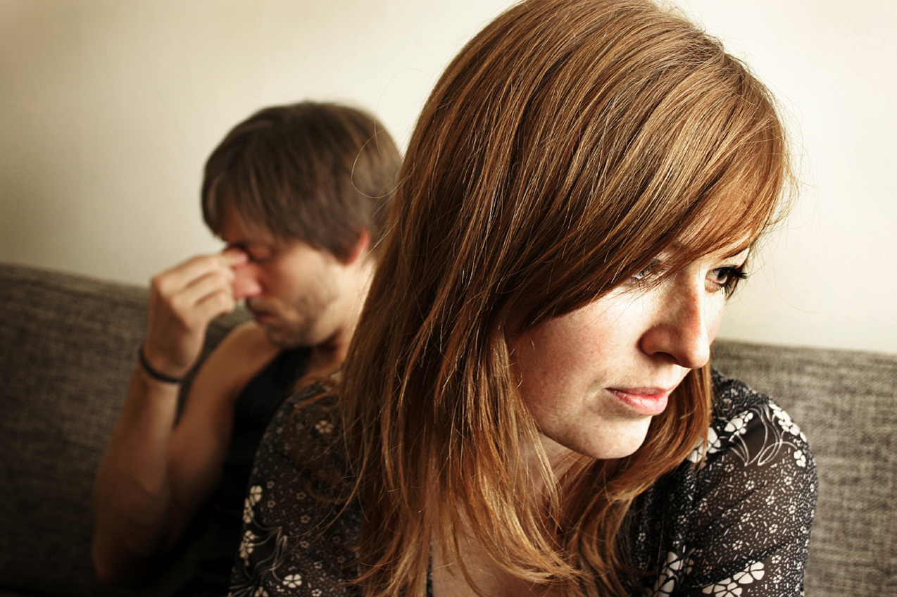
Go in Person
34d
NOT:
Email
Text
Letter
Phone

Slide 23
Matthew's Relational Pillars
Matthew's Relational Pillars
5:23-24
18:15-17
You are:
Offender
Offended
Issue:
General
Sin
Initiative:
You!
You!

Slide 24

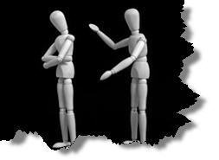
Why don't we confront others?
34d
Ignorance
Doubt
Failure
Fear
Excuses
Impurity
Unsocial

Slide 25
Step 1 to Restoration
Talk to the person by yourself
34d
M
M
M
M
M
M
M
M
M
M
M
M
M
M
M
M
S
M
M
M
M
M
M
M
M
M
M
M
S = Sinner
M = Member

Slide 26
Step 2 to Restoration
Take 1-2 others along
34d
M
M
M
M
M
M
M
M
M
M
M
M
M
M
M
M
S
M
M
M
M
M
M
M
M
M
M
M
S = Sinner
M = Member

Slide 27

Questions on Step 2
Who should these people be?
Why take 1-2 others?
Notes:
Instead of restoring nets, share about a genuine reconciliation between people.
08.27 adapted in 16.20

Slide 28
Deut. 19:15
"One witness is not enough to convict a man accused of any crime or offense he may have committed. A matter must be established by the testimony of two or three witnesses."

Slide 29
Step 3 to Restoration
Expose the sin to the entire church
34d
M
M
M
M
M
M
M
M
M
M
M
M
M
M
M
M
S
M
M
M
M
M
M
M
M
M
M
M
S = Sinner
M = Member

Slide 30
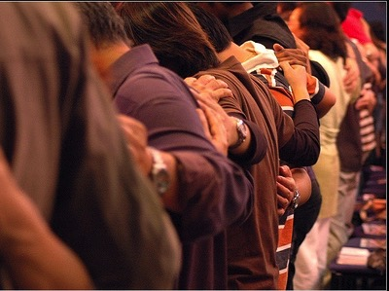
Why tell the whole church?

Slide 31
Step 4 to Restoration
Treat the person like an unbeliever
34d
M
M
M
M
M
M
M
M
M
M
M
M
M
M
M
M
S
M
M
M
M
M
M
M
M
M
M
M
S = Sinner
M = Member
S

Slide 32

Sins Worthy of Discipline
How NOT to Discipline
EXCOMMUNICATE !
Notes:
Sometimes we can show what to do by also telling first what NOT to do…
08.32
16.14

Slide 33

Sins Worthy of Discipline
How to Discipline Him/Her
34d
Don't refer to him/her as a Christian.
Evangelize this person.
Don't let him/her take the Lord's Supper.
Remove the person from membership.
Remove this person from church roles.
Unbeliever
"Deliver over to Satan" one in sex sin
(1 Cor. 5:5).
Don't eat with him/her (1 Cor. 5:11).
Prohibit him/her from attending church?
Worse
Notes:
08.33
16.15

Slide 34
The Point of Verses 15-17
34c
I. The way the church should correctly restore a sinning Christian is by keeping the matter as private as possible (15-17).

Slide 35
God's 4-step restoring process…
34c
4
3
2
1
…reveals the issue to more people each step
Notes:
08.35
11.28

Slide 36
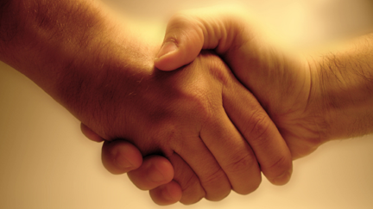
Our 2nd question is answered in verses 18-20:
Why do we restore sinning Christians properly?
34c
Notes:
08.36
11.29

Slide 37

The Point of Verses 18-20
34c
II. The reason the church can restore or continue to seek to restore errant believers is because it extends God’s authority!
Notes:
08.37 but changed to HO SP in:
11.30
12.21

Slide 38
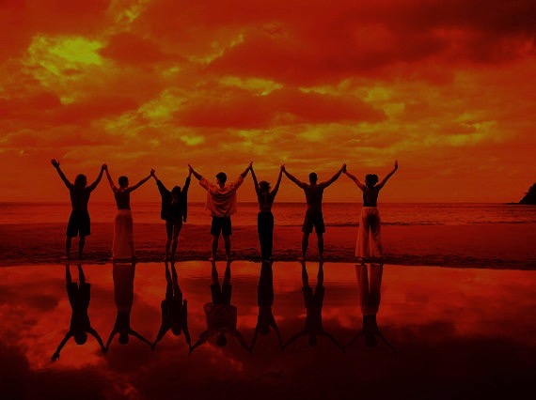
Why discipline?
When the church seeks to restore someone…
34c
The local church acts in the place
of the Father
(18-19)

Slide 39
A Better Translation…
NAU is a Better Translation…
NIV "I tell you the truth, whatever you bind on earth
will be {or have been} bound in heaven, and whatever you loose on earth will be {or have been} loosed in heaven."
NAU "Truly I say to you, whatever you bind on earth shall have been bound in heaven; and whatever you loose on earth shall have been loosed in heaven."

Slide 40

Matthew 18:19
"Again, I tell you that if two of you on earth agree about anything you ask for, it will be done for you by my Father in heaven" (NIV).
Notes:
Who are the “two of you”? Are these people in prayer?
No. The immediate context in verse 16 refers to the two witnesses of the sinner’s lack of repentance.
So when these witnesses—some undoubtedly in church leadership–agree as they prayerfully consider God’s will about one in sin, then God the Father is with them in this difficult time.

Slide 41
Psalm 82:1, 6
(to Israel's rulers/gods)
"I said, 'You are "gods"; you are all sons of the Most High… but you will die like men…"
Notes:
08.41
God extended his authority to Israel’s rulers in the OT where they acted in the place of God as little ”gods.”
In like manner, he has appointed church leaders as his human representatives to act for him.
In both cases, heaven does not follow us—but rather, we follow heaven’s dictates in the Bible.

Slide 42
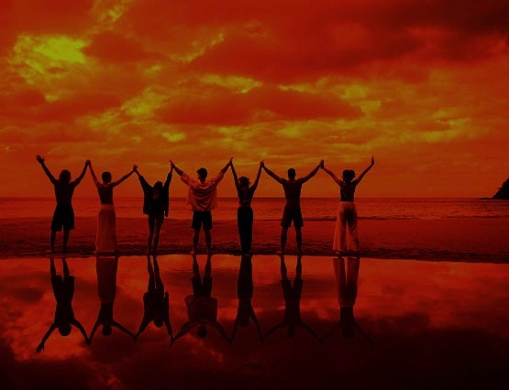
Why discipline?
When the church seeks to restore someone…
34c
The local church acts in the place
of the Father
(18-19)
The local church acts in the presence & authority of Christ
(20)

Slide 43
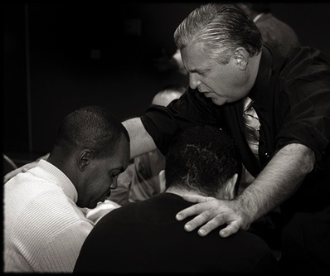
Matthew 18:20
"For where
two or three come together in my name, there I am with them" (NIV).
Notes:
As in verses 16 and 19, these two or three relate not to prayer but to the church discipline case in the context.
They may and certainly should pray, but this verse speaks not of prayer in general but the fact that Jesus is present in the difficult decision they must make about the person in sin.

Slide 44
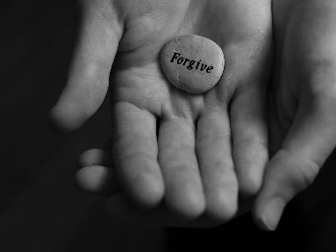
Exegetical Idea:
34c
The reason the church should restore a sinning Christian correctly is because it extends God's authority.
Notes:
08.44 but changed to HO in:
11.31
12.22

Slide 45

We can exegete music too
6
Summarize "A Mighty Fortress" in a sentence on page 6

Slide 46
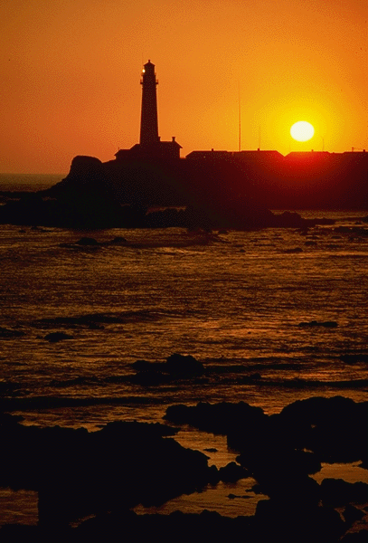
Verse 1
31
A Mighty Fortress is our God,
A bulwark never failing;
Our helper He amid the flood
Of mortal ills prevailing.
For still our ancient foe
Doth seek to work us woe
His craft and pow'r are great,
And armed with cruel hate,
On earth is not his equal.

Slide 47

Verse 2
31
Did we in our own strength confide,
Our striving would be losing,
Were not the right man on our side,
The man of God's own choosing,
Dost ask who that may be?
Christ Jesus, it is He
Lord Sabaoth His name,
From age to age the same,
And He must win the battle.

Slide 48
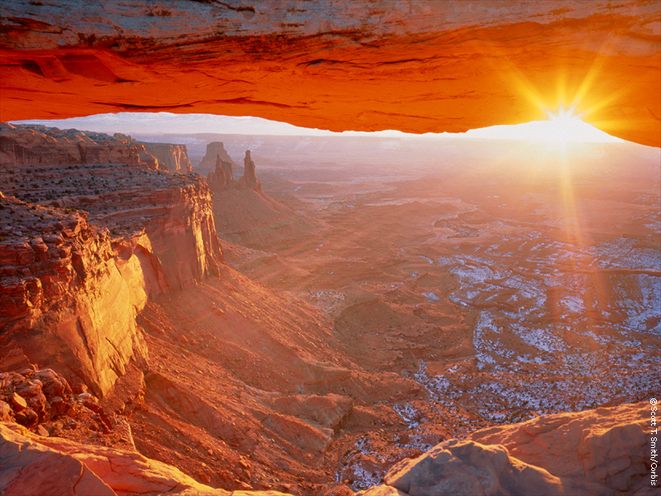
Verse 3
31
And tho' this world, with devils filled,
Should threaten to undo us,
We will not fear, for God hath willed
His truth to triumph through us.
The prince of darkness grim,
We tremble not for him,
his rage we can endure,
For lo, his doom is sure:
One little word shall fell him.

Slide 49
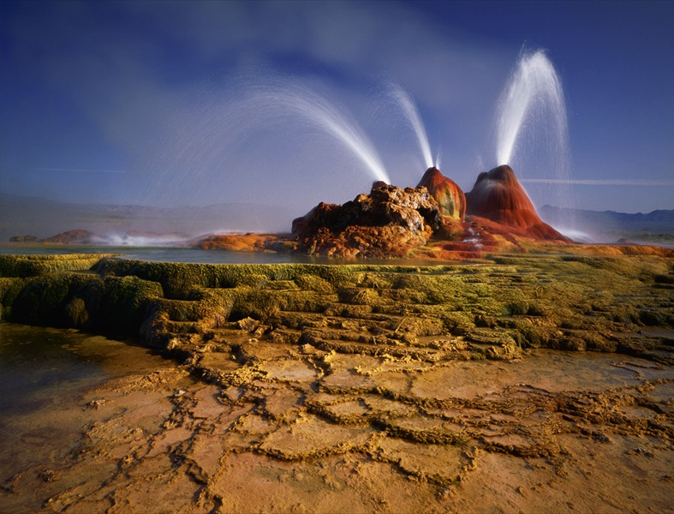
Verse 4
31
That word above all earthly pow'rs,
No thanks to them, abideth;
The Spirit and the gifts are ours
through Him who with us sideth.
Let goods and kindred go,
This mortal life also
The body they may kill;
God's truth abideth still:
his Kingdom is forever!

Slide 50
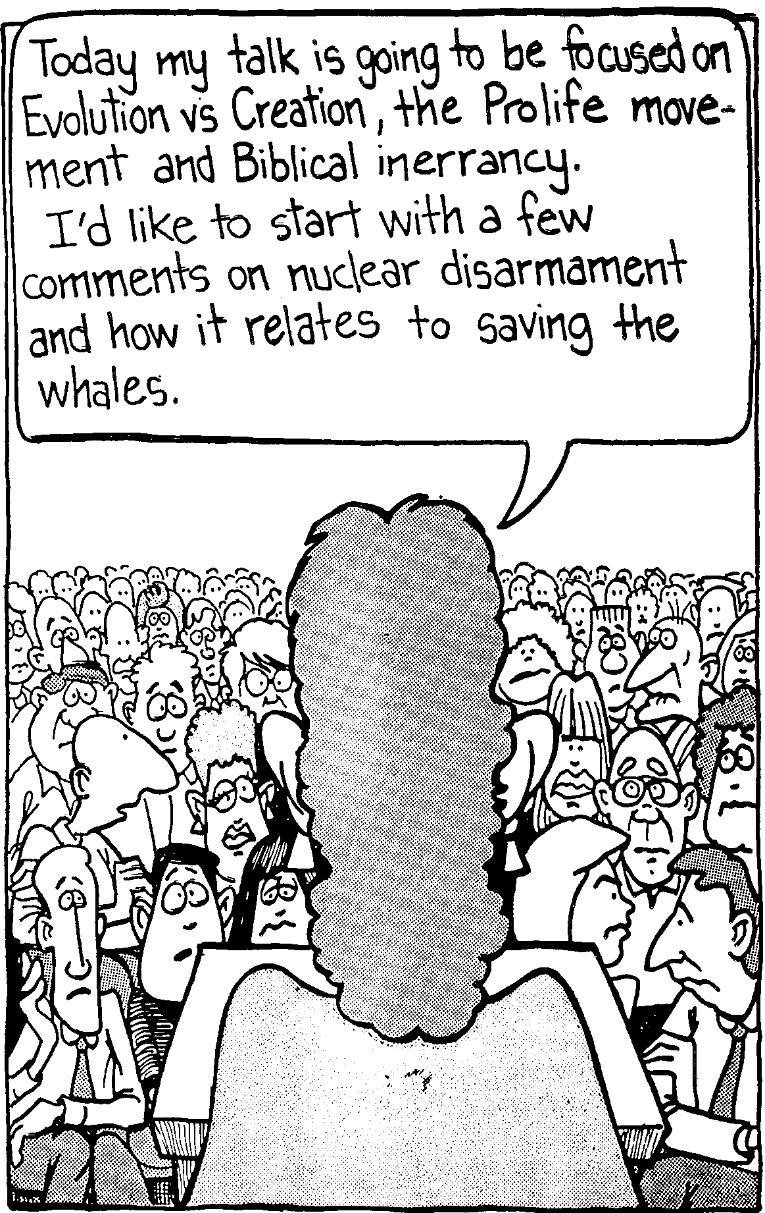
Every talk needs focus!
Today my talk will focus on Evolution vs Creation, the Prolife movement and biblical inerrancy. I’d like to start with a few comments on nuclear disarmament and how it relates to saving the whales.

Slide 51

What do you do for a living?
What do you do for a living?
I work.

Slide 52
Could you be more vague?
Could you be more vague?
Be specific!

Slide 53
The Preparing Expository Sermons Process
27-28, 251
Based on Ramesh Richard's text, Preparing Expository Sermons
TEXT
SERMON
5 Desired Listener Response
Brain
4 The Three
Developmental
Questions
Purpose Bridge
3.2 Exegetical Idea
CPT
Heart
CPS
6 Homiletical Idea
7 Homiletical
Outline
8 Clarity
9 Intro/Concl
3.1 Exegetical
Outline
Structure
Skeleton
Structure
2 Analyze Text
Study
Flesh
Preach
10 MSS &
Preach
1 Choose Text
White text shows 10 steps adapted from Haddon Robinson, Biblical Preaching (notes, 105)
Notes:
Cover steps 1-3 on page 27

Slide 54
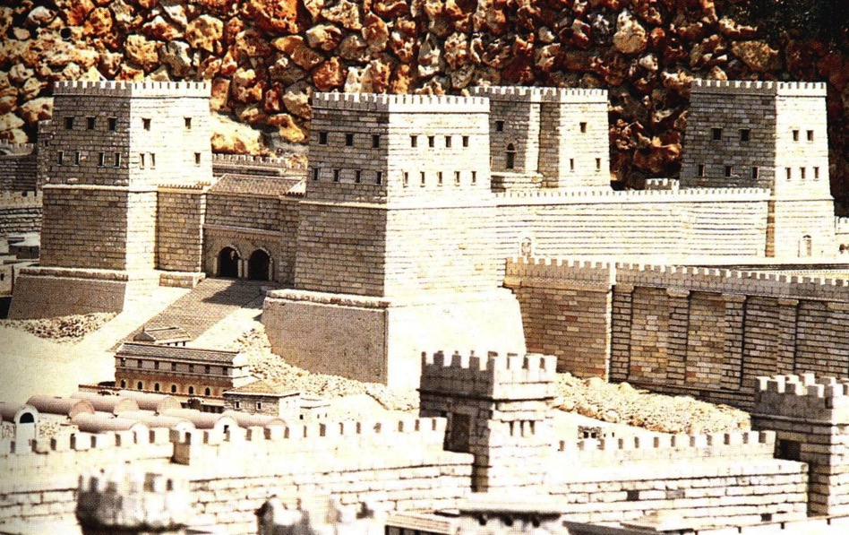
Exegetical Outlining
31
How did you get your
subject-complement for
"A Mighty Fortress"
(Assignment #2 on p. 6)?

Slide 55
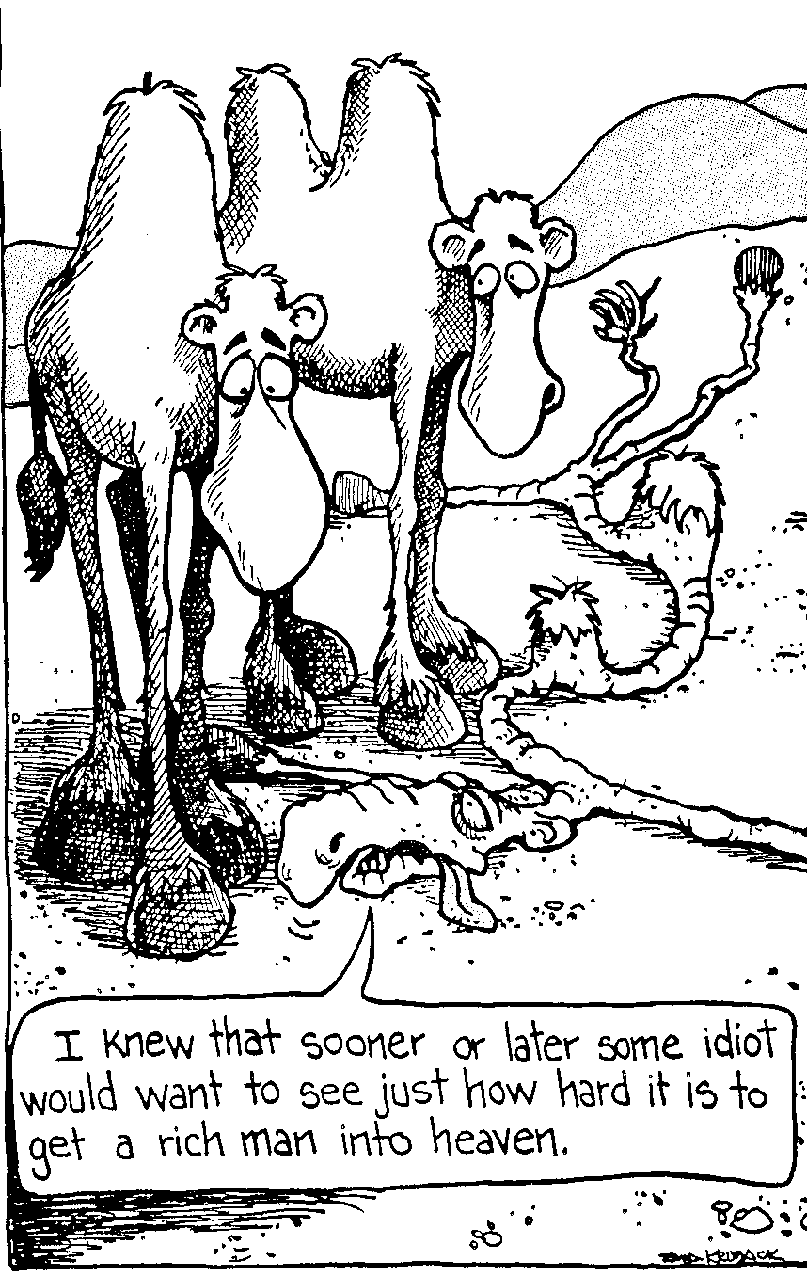
A good process can help get the right meaning of the text
I knew that sooner or later some idiot would want to see just how hard it is to get a rich man into heaven.

Slide 56
Three Steps to Exegetical Outlining (Basic Form)
31
Reword each verse to remove all figures of speech.
For example, what does it mean to have God as "A Mighty Fortress"?

Slide 57
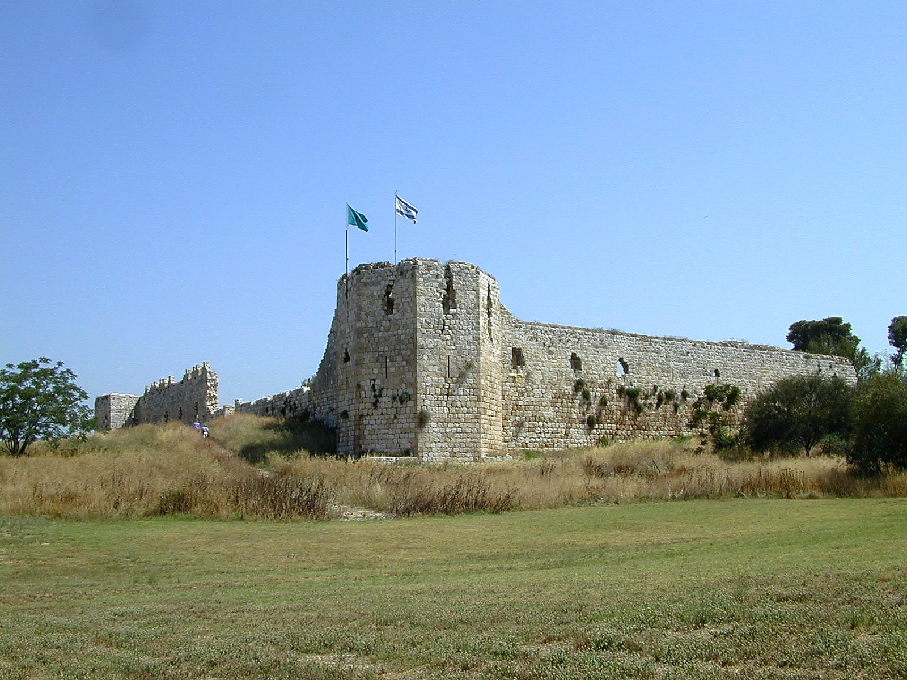
Aphek Turkish Fortress

Slide 58
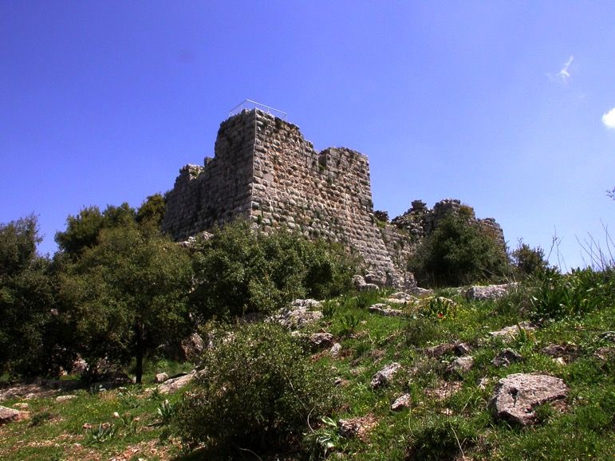
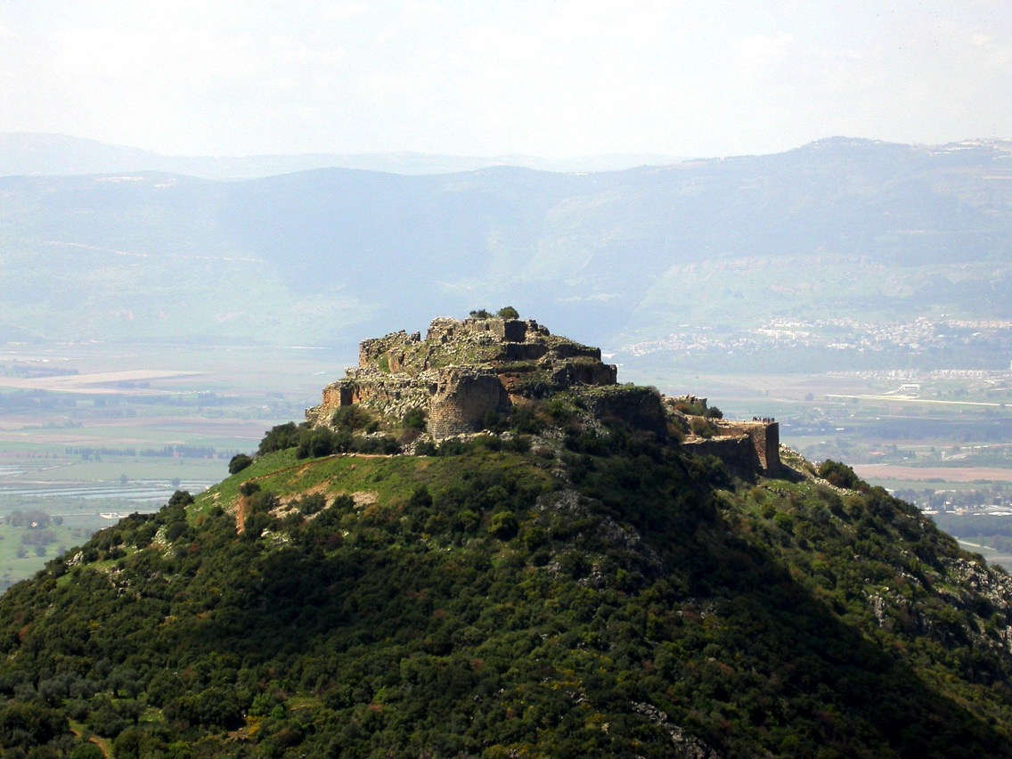
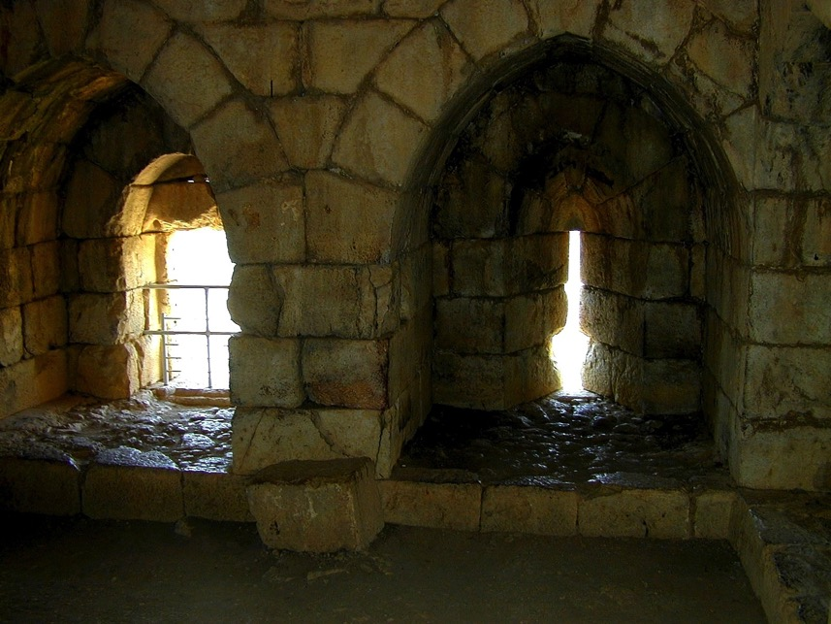
Nimrod's Fortress

Slide 59
Verse 1
31
A Mighty Fortress is our God,
A bulwark never failing;
Our helper He amid the flood
Of mortal ills prevailing.
=
God is our unfailing refuge and helper in all human difficulties

Slide 60
Verse 1
31
For still our ancient foe
Doth seek to work us woe
His craft and pow'r are great,
And armed with cruel hate,
On earth is not his equal.
=
No human can defeat Satan's experienced trickery, power and hate which hinders us.

Slide 61
Three Steps to Exegetical Outlining (Basic Form)
31
A. Reword each verse to remove all figures of speech.
B. Group similar statements under main titles to reveal major divisions in the passage.
C. Write out these "major hunks," then make sure the sub-points (SPs at "A" level) really do fit under each major hunk.

Slide 62
Verse 1
31
God is our unfailing refuge and helper in all human difficulties
+
No human can defeat Satan's experienced trickery, power and hate which hinders us.
=
God is our unfailing refuge against Satan's powerful devices (1).

Slide 63
Summing up vv. 1-2 into a Main Point
31
God is our unfailing refuge against Satan's powerful devices (1)
+
God chose Christ as our omnipotent and eternal strength for victory [over Satan] (2)
=
I. God has provided triumph over Satan only through Christ (1-2).

Slide 64
Needed in Your Main Idea…
Assignment 2 Grading Guide
31
God: 7 times (-7%)
Satan/devils/powers: 10 times (-10%)
Christ/Lord: 7 times (-7%)
Victory/Triumph: 11 times (-11%)
Word/Truth: 4 times (-4%)
Faith/Trust/Depend: 2 times (-2%)
Total to deduct (-40%)
(Christians also noted 17 times!)
Notes:
"God" = full credit for "Father"
"Satan" stated as "Trouble/Trials/Sufferings/Battle/World/Evil" (-5%); Full credit for "darkness" & "enemies" & "enemy"
"Christ/Lord" granted full credit also for "Savior" & "salvation" & "defender"
"Victory/Triumph" as well as granting full credit for "Deliver" or "Refuge" or "Rule" or "Never Fails" or "Strength" or "Protection" or "Defense" or "Security"; Also partial credit for "Help/Protect" (-5%); "Power/ful" (-2%); "only one" (-5%)
"Word/Truth" as "Affirmation" granted full credit
"Faith/Trust/Depend" granted full credit, as well as "not fear" & "assurance" & "security" & "rely on" & "confidence" & "hope"
Mentioning "Mighty" (-2%) or "Fortress" (-2%)
Subject or Complement not one sentence but a list of sentences (-5%)

Slide 65
Verse 1
31
A Mighty Fortress is our God,
A bulwark never failing;
Our helper He amid the flood
Of mortal ills prevailing.
For still our ancient foe
Doth seek to work us woe
His craft and pow'r are great,
And armed with cruel hate,
On earth is not his equal.

Slide 66
Verse 2
31
Did we in our own strength confide,
Our striving would be losing,
Were not the right man on our side,
The man of God's own choosing,
Dost ask who that may be?
Christ Jesus, it is He
Lord Sabaoth His name,
From age to age the same,
And He must win the battle.

Slide 67
Verse 3
31
And tho' this world, with devils filled,
Should threaten to undo us,
We will not fear, for God hath willed
His truth to triumph through us.
The prince of darkness grim,
We tremble not for him,
his rage we can endure,
For lo, his doom is sure:
One little word shall fell him.

Slide 68
Verse 4
31
That word above all earthly pow'rs,
No thanks to them, abideth;
The Spirit and the gifts are ours
through Him who with us sideth.
Let goods and kindred go,
This mortal life also
The body they may kill;
God's truth abideth still:
his Kingdom is forever!

Slide 69
Needed in Your Main Idea…
Assignment 2 Grading Guide
31
God: 7 times (-7%)
Satan/devils/powers: 10 times (-10%)
Christ/Lord: 7 times (-7%)
Victory/Triumph: 11 times (-11%)
Word/Truth: 4 times (-4%)
Faith/Trust/Depend: 2 times (-2%)
Total to deduct (-40%)
(Christians also noted 17 times!)
Notes:
"God" = full credit for "Father"
"Satan" stated as "Trouble/Trials/Sufferings/Battle/World/Evil" (-5%); Full credit for "darkness" & "enemies" & "enemy"
"Christ/Lord" granted full credit also for "Savior" & "salvation" & "defender"
"Victory/Triumph" as well as granting full credit for "Deliverer" or "Refuge" or "Rule" or "Never Fails" or "Strength" or "Protection" or "Defense" or "Security"; Also partial credit for "Help/Protect" (-5%); "Power/ful" (-2%)
"Word/Truth" as "Affirmation" granted full credit
"Faith/Trust/Depend" granted full credit, as well as "not fear" & "assurance" & "security" & "rely on" & "confidence" & "hope"
Mentioning "Mighty" (-2%) or "Fortress" (-2%)
Subject or Complement not one sentence but a list of sentences (-5%)

Slide 70
Black

Slide 71


Preaching (Homiletics) link at BibleStudyDownloads.org
Get this presentation for free!
Notes:
Preaching (pr)
Homiletics

